Slide 1
CuSVD
By
Anurag Bansal
(Enrollment No: 19114010)

Slide 2
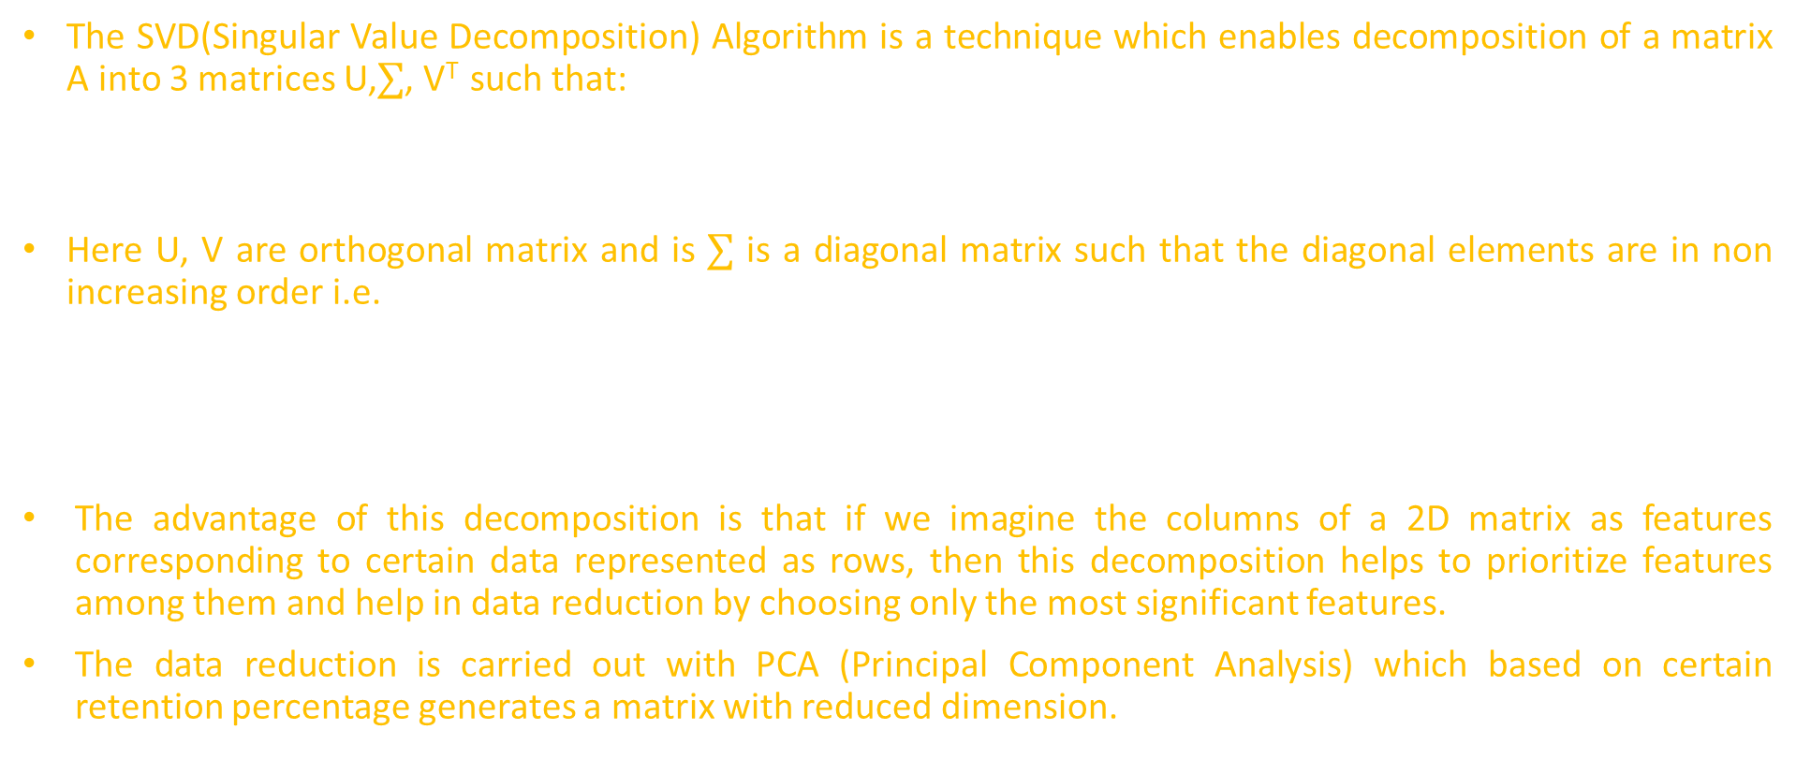
Introduction to SVD
The SVD(Singular Value Decomposition) Algorithm is a technique which enables decomposition of a matrix A into 3 matrices U,$∑$, V^{T} such that:
A = U $∑$V^{T}
Here U, V are orthogonal matrix and is $∑$ is a diagonal matrix such that the diagonal elements are in non increasing order i.e.
$$∑[i][i] >=∑ [j][j] for i>j$$
The advantage of this decomposition is that if we imagine the columns of a 2D matrix as features corresponding to certain data represented as rows, then this decomposition helps to prioritize features among them and help in data reduction by choosing only the most significant features.
The data reduction is carried out with PCA (Principal Component Analysis) which based on certain retention percentage generates a matrix with reduced dimension.

Slide 3
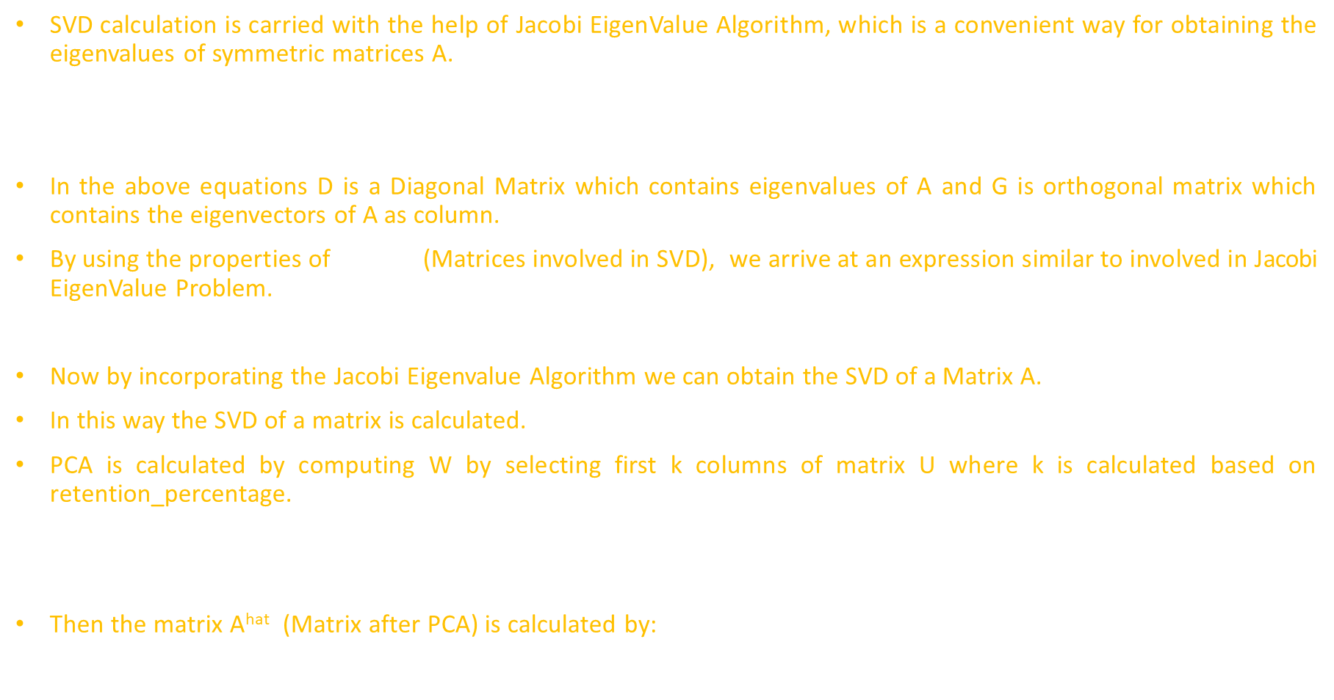
Theory
SVD calculation is carried with the help of Jacobi EigenValue Algorithm, which is a convenient way for obtaining the eigenvalues of symmetric matrices A.
A = GDG^{T}
GG^{T}= I
In the above equations D is a Diagonal Matrix which contains eigenvalues of A and G is orthogonal matrix which contains the eigenvectors of A as column.
By using the properties of U,$∑$, V^{T} (Matrices involved in SVD), we arrive at an expression similar to involved in Jacobi EigenValue Problem.
A^{T} A = V$∑$² V^{T}
Now by incorporating the Jacobi Eigenvalue Algorithm we can obtain the SVD of a Matrix A.
In this way the SVD of a matrix is calculated.
PCA is calculated by computing W by selecting first k columns of matrix U where k is calculated based on retention_percentage.
W = U[:,0:k] # Syntax in Python
Then the matrix A^{hat} (Matrix after PCA) is calculated by:
A^{hat} = AW

Slide 4
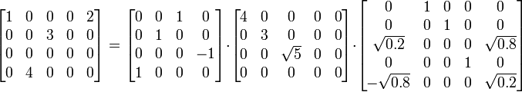
Example of SVD

Slide 5
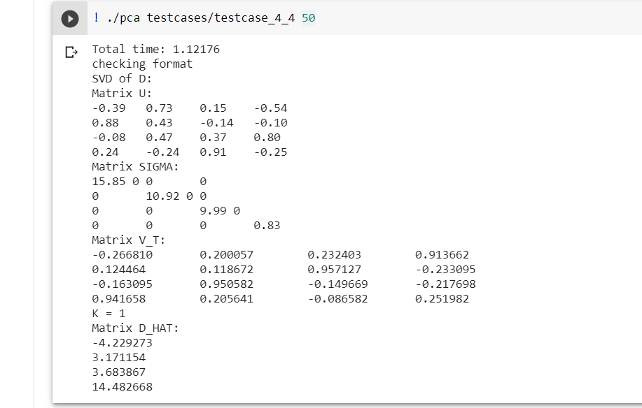
Results
Input:
4 4
2 -3 1 -3 1 2 4 9 6 8 4 -3 -8 12 -3 2

Slide 6
References
https://en.wikipedia.org/wiki/Jacobi_eigenvalue_algorithm
https://en.wikipedia.org/wiki/Singular_value_decomposition
CS334 on Udacity

